Slide 1
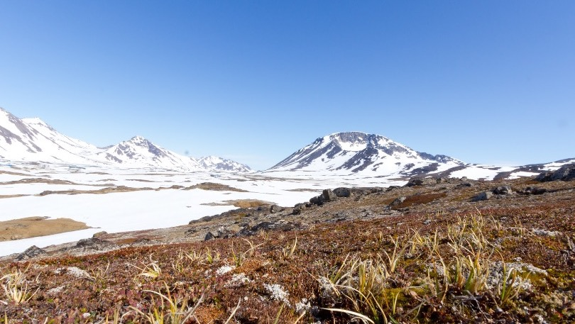


Paleoecology of the Camp Century subglacial sediment core, Northwest Greenland
A master’s thesis proposal presentation
by
Halley Mastro
Members of the thesis committee:
Paul R. Bierman, PhD, Advisor
Cathy Paris, PhD, Chair
Ana Morales-Williams, PhD
Photo: Josh Brown, UVM

Slide 2
Overview
Background
Methods
Results
Implications
Future Work
Timeline
Background:
  Why should we study ecosystems in Greenland?
  How can the past inform the present?
Methods:
  Macrofossil and wood anatomical analysis
  Organic geochemistry
Preliminary results and interpretations
Implications
Future work and timeline

Slide 3
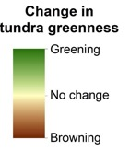
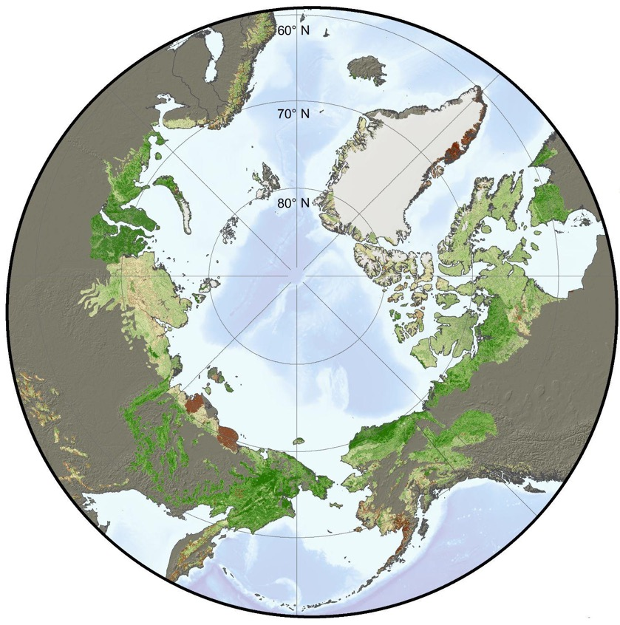
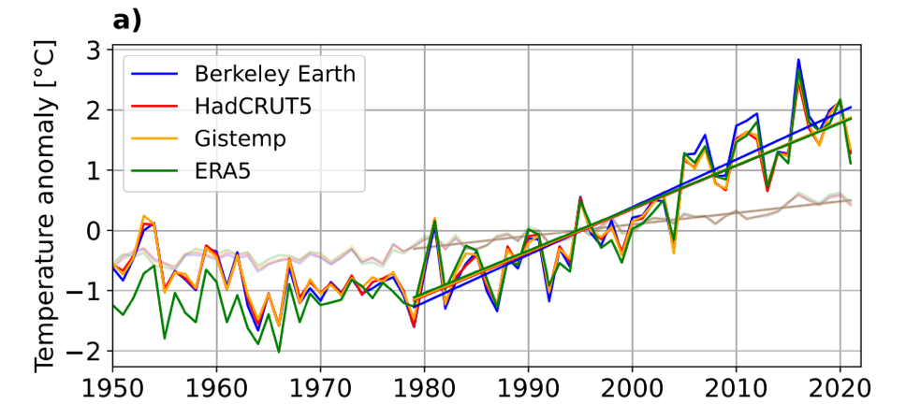
The Arctic is changing
Background
Methods
Results
Implications
Future Work
Timeline
Dark lines= Arctic
Light lines= Global
2000-2016
Rantanen et al. 2022
NASA, 2021

Slide 4
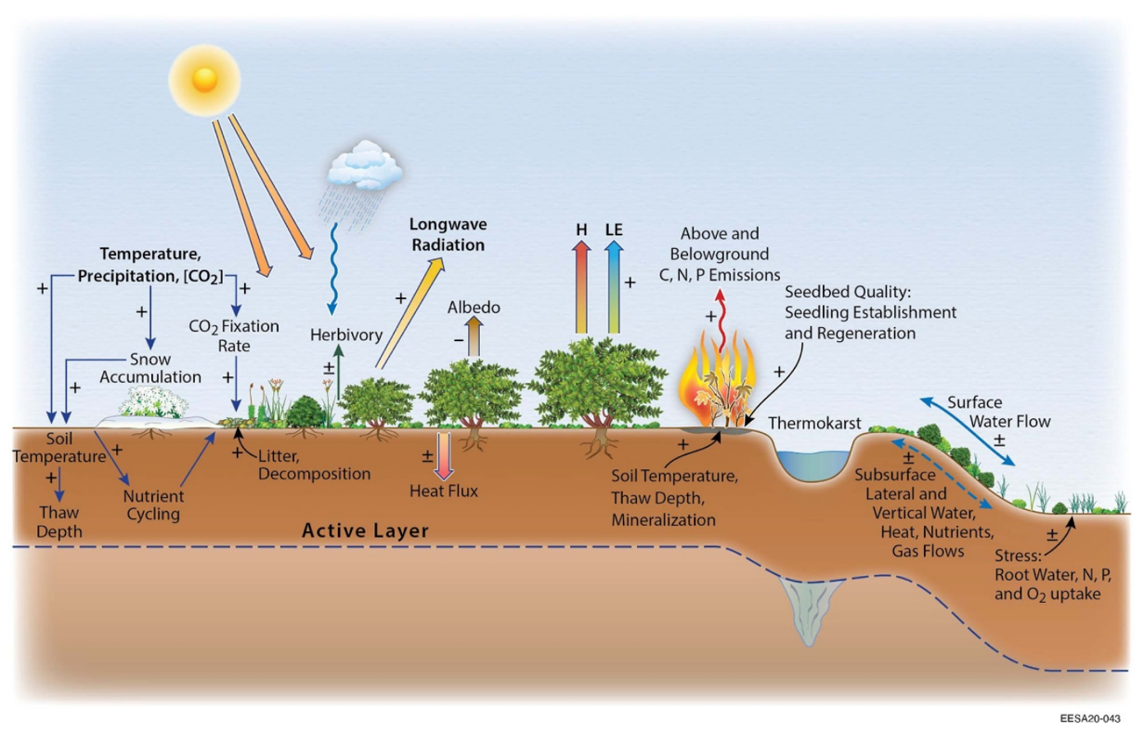
Arctic vegetation responds to and interacts with changes in the atmosphere and soil
Background
Methods
Results
Implications
Future Work
Timeline
Mekonnen et al. 2021

Slide 5
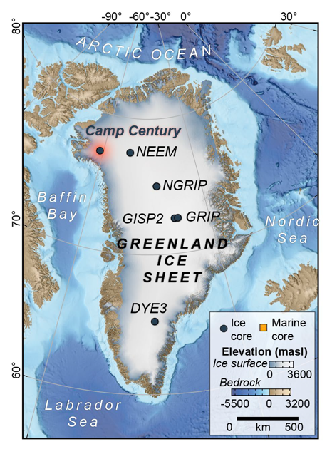
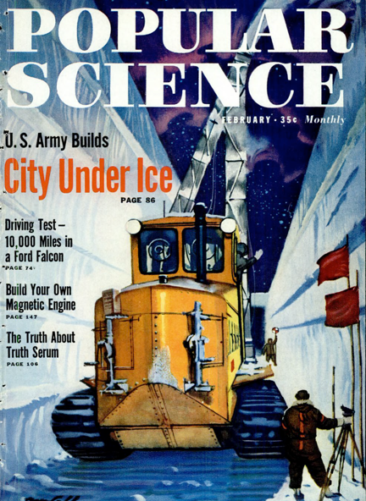
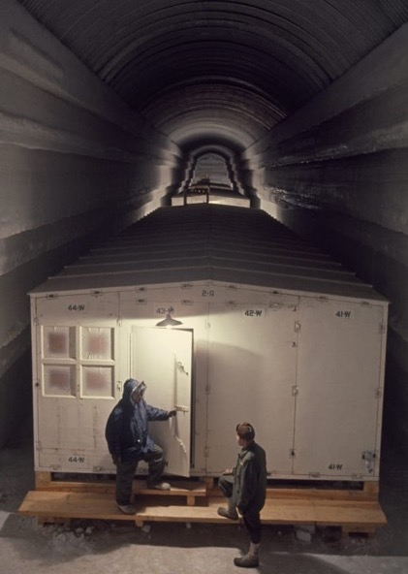
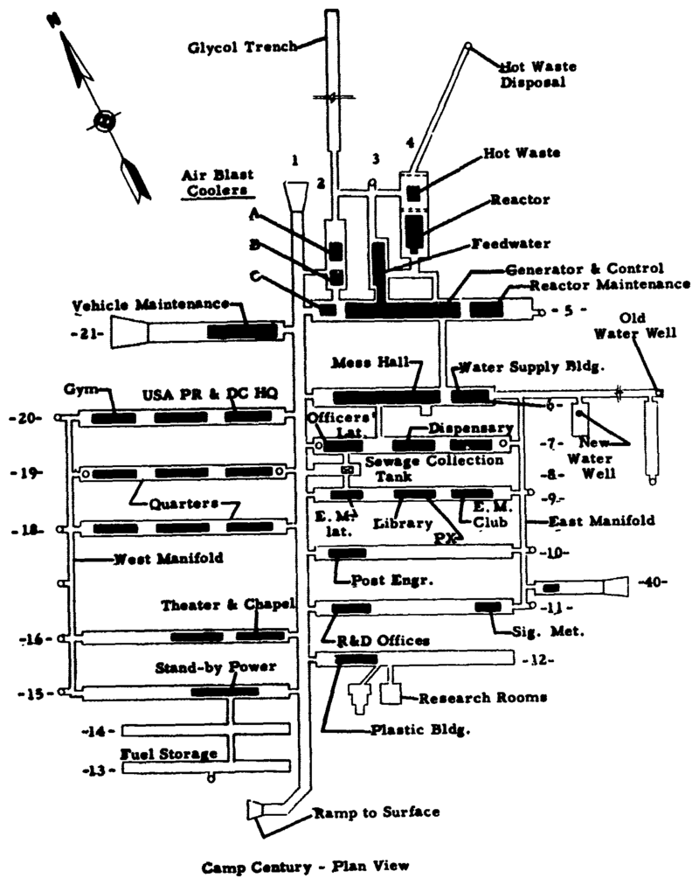
Background
Methods
Results
Implications
Future Work
Timeline
Archive history: Project ice worm

Slide 6
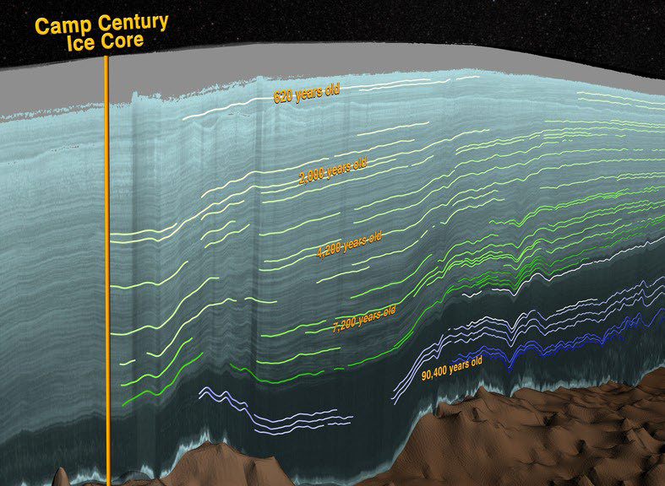
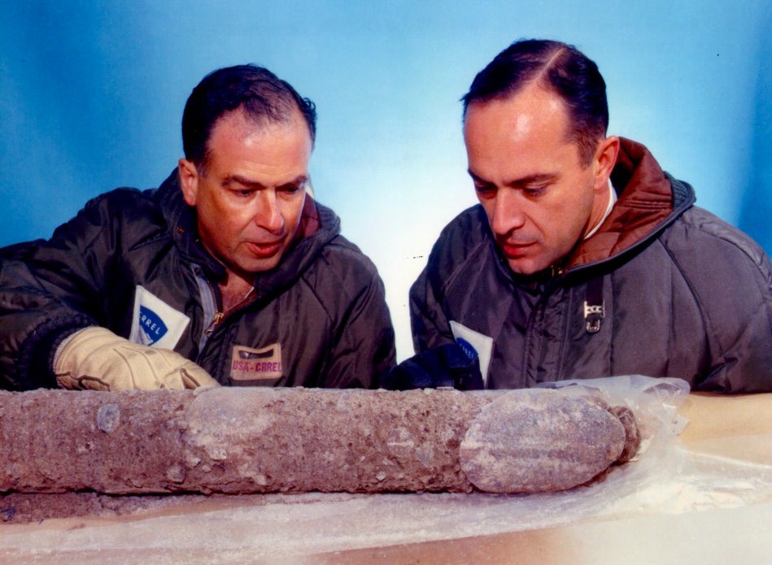
Archive history: Project Ice Worm
Background
Methods
Results
Implications
Future Work
Timeline
Archive history: The first deep ice core

Slide 7
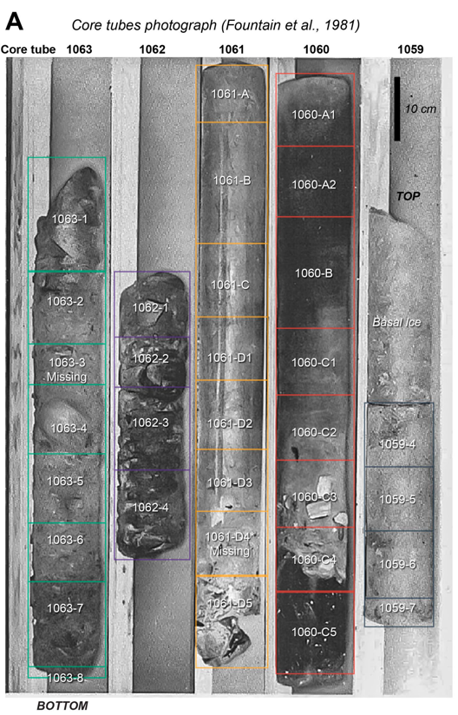

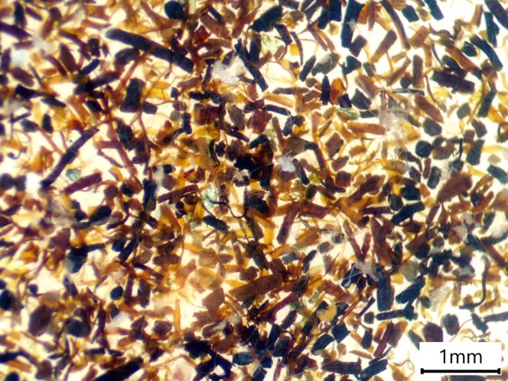
Terrestrial record of reduced Greenland ice sheet extent during the Pleistocene
Background
Methods
Results
Implications
Future Work
Timeline
~416 ka
1.4-3.2 Ma

Slide 8
Research questions
Background
Methods
Results
Implications
Future Work
Timeline
What was the composition of emergent ecosystems at Camp Century during the ice-free periods represented in the core?
What environmental and climatic conditions would support the development of such ecosystems?
Location of pre-Holocene organic-bearing
archives in Greenland

Slide 9
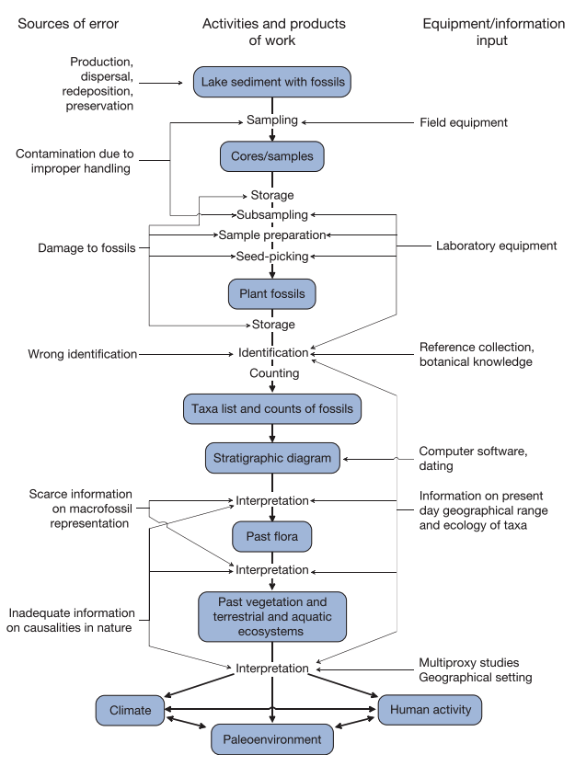
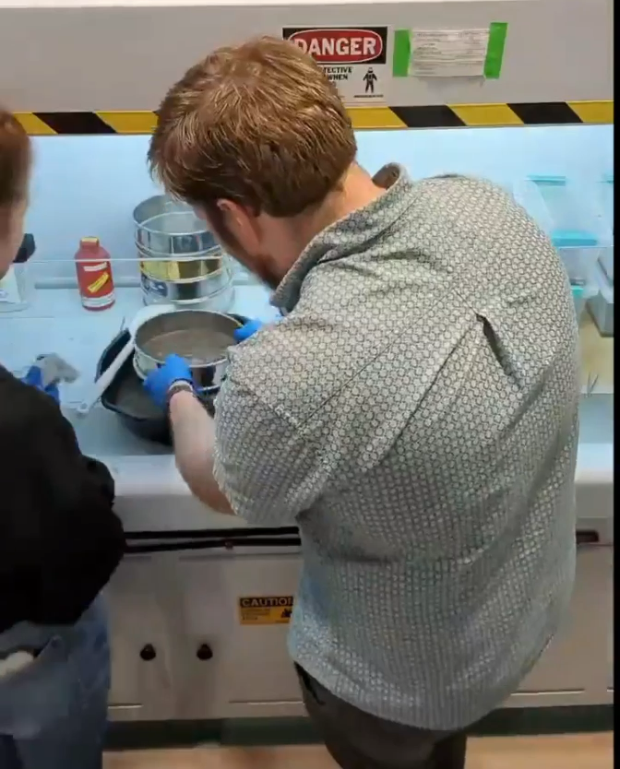
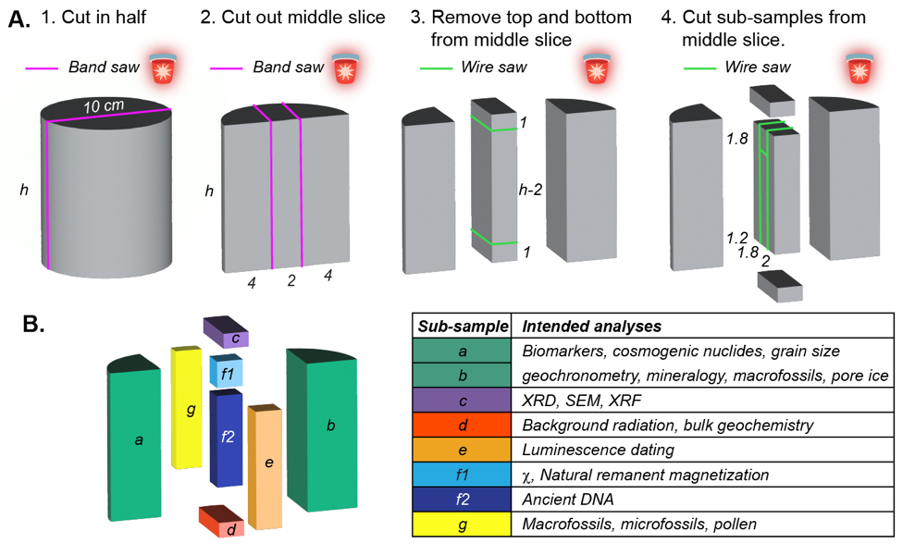
Initial processing and macrofossil analysis
Background
Methods
Results
Implications
Future Work
Timeline

Slide 10
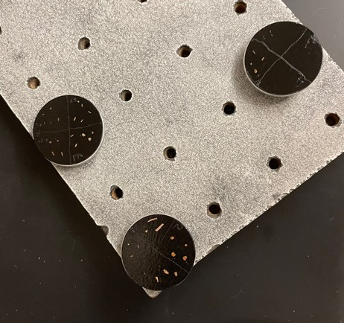
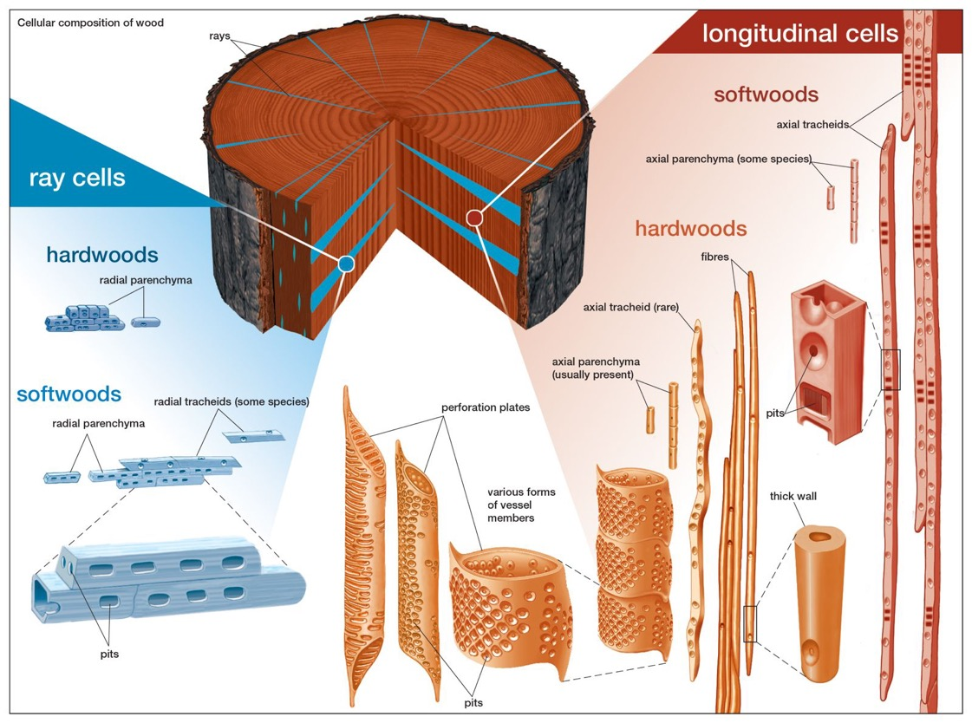
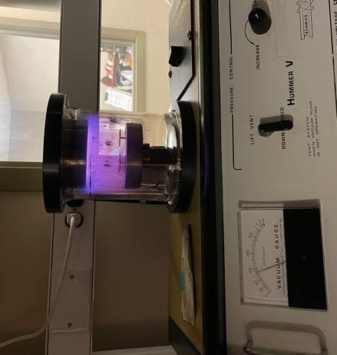
Wood anatomical analysis
Background
Methods
Results
Implications
Future Work
Timeline

Slide 11
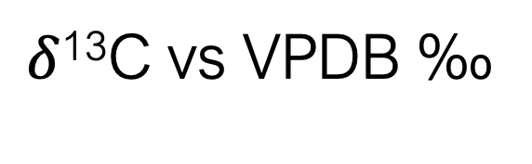
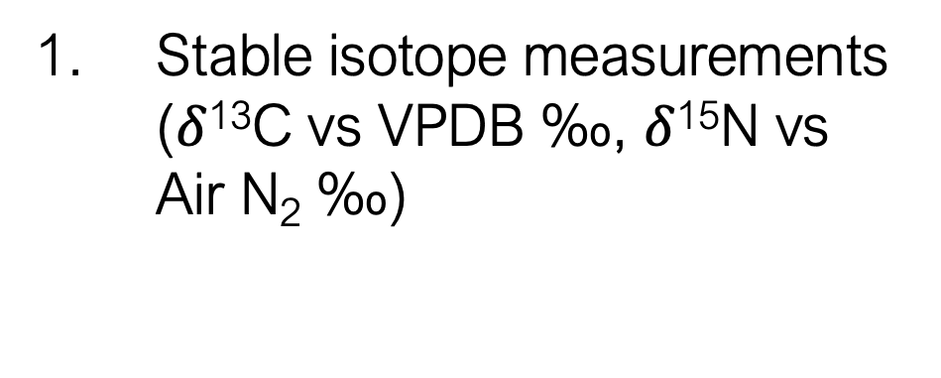
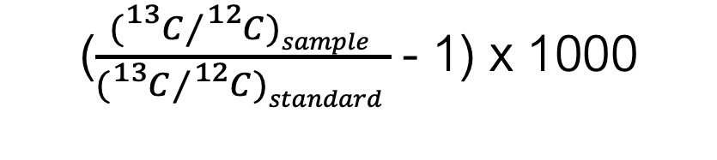
Organic geochemistry: Bulk organic material
Background
Methods
Results
Implications
Future Work
Timeline
Isotope | Neutron Number | Mass Number | Abundance (%)
Carbon-12 | 6 | 12 | 98.89
Carbon-13 | 7 | 13 | 1.11
Carbon-14 | 8 | 14 | <0.0001
Stable isotope measurements ($δ$¹³C vs VPDB ‰, $δ$¹⁵N vs Air N₂ ‰)
Measure using coupled flow elemental analyzer and mass spectrometer
($\frac{({}_{}^{13}C⁄{}_{}^{12}{C)sample }}{({}_{}^{13}C⁄{}_{}^{12}{C)standard }}$- 1) x 1000
Comparable values on accepted scale
$δ$¹³C vs VPDB ‰

Slide 12
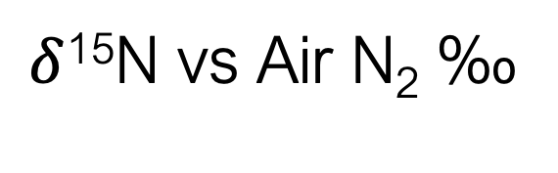
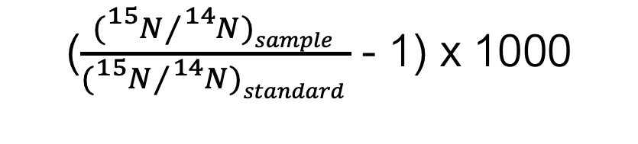
Organic geochemistry: Bulk organic material
Background
Methods
Results
Implications
Future Work
Timeline
Isotope | Neutron Number | Mass Number | Abundance (%)
Nitrogen-14 | 7 | 14 | 99.64
Nitrogen-15 | 8 | 15 | 0.35
Stable isotope measurements ($δ$¹³C vs VPDB ‰, $δ$¹⁵N vs Air N₂ ‰)
Measure using coupled flow elemental analyzer and mass spectrometer
($\frac{({}_{}^{15}N⁄{}_{}^{14}{N)sample }}{({}_{}^{15}N⁄{}_{}^{14}{N)standard }}$- 1) x 1000
Comparable values on accepted scale
$δ$¹⁵N vs Air N₂ ‰

Slide 13
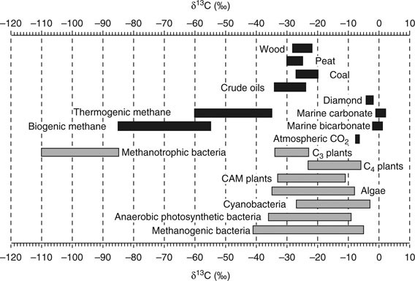
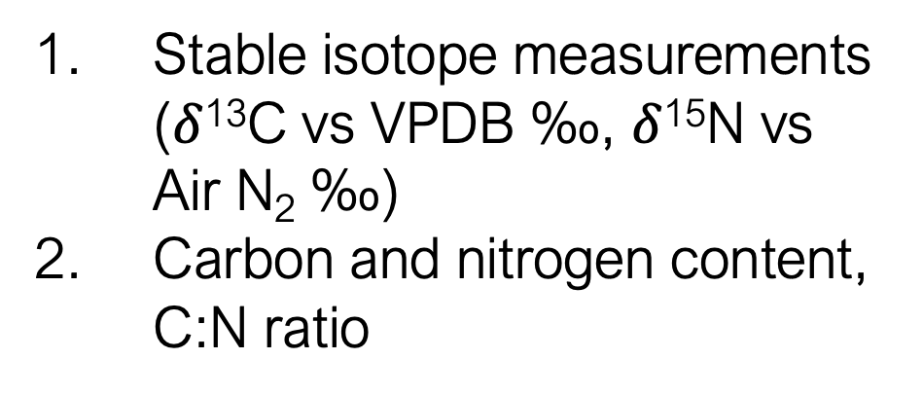
Organic geochemistry: Bulk organic material
Background
Methods
Results
Implications
Future Work
Timeline
Stable isotope measurements ($δ$¹³C vs VPDB ‰, $δ$¹⁵N vs Air N₂ ‰)
Carbon and nitrogen content, C:N ratio
Vieth and Wilkes 2010

Slide 14
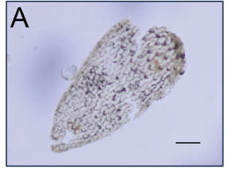
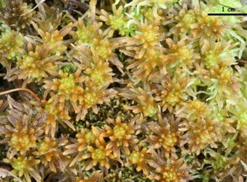
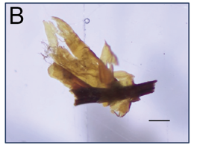
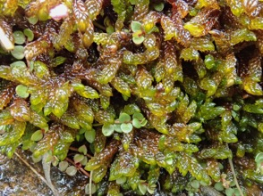
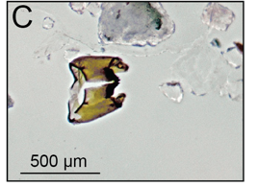
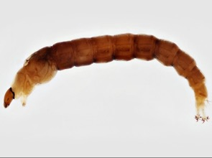
Moss, freshwater invertebrate and terrestrial plant macrofossils illustrate Arctic tundra conditions at Camp Century.
Background
Methods
Results
Implications
Future Work
Timeline
Sphagnum sp. leaf
Scorpidium
scorpioides leaves and stem
Chironomid larval head capsule

Slide 15
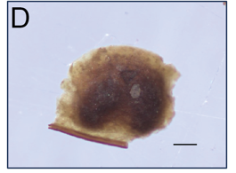
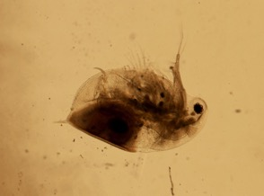
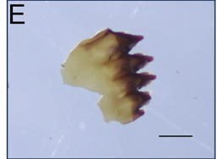
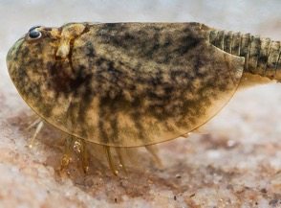
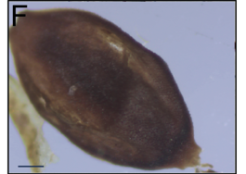
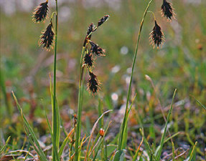
Moss, freshwater invertebrate and terrestrial plant macrofossils illustrate Arctic tundra conditions at Camp Century.
Background
Methods
Results
Implications
Future Work
Timeline
Daphnia pulex resting egg pouch
Lepidurus arcticus mandible
Carex seed

Slide 16
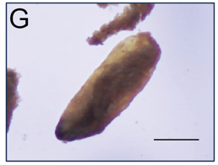
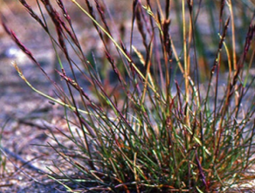
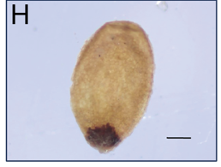
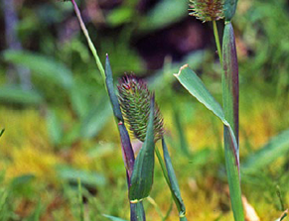
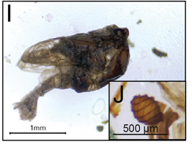
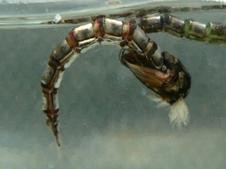
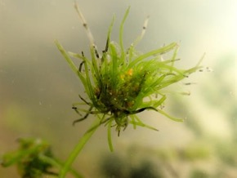
Moss, freshwater invertebrate and terrestrial plant macrofossils illustrate Arctic tundra conditions at Camp Century.
Background
Methods
Results
Implications
Future Work
Timeline
Poaceae caryopsis
Juncaceae seed
Chironomid pupa fragment
Tolypella sp. oospore

Slide 17
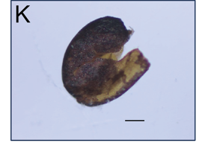
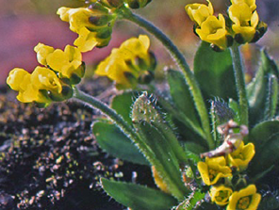
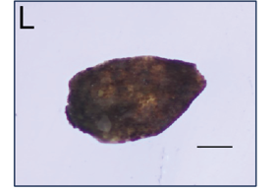
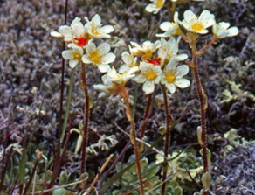
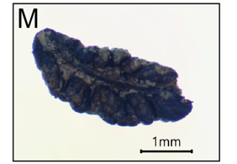

Moss, freshwater invertebrate and terrestrial plant macrofossils illustrate Arctic tundra conditions at Camp Century.
Background
Methods
Results
Implications
Future Work
Timeline
Draba sp. seed
Saxifraga cf. paniculata seed
Dryas octopetala leaf

Slide 18






Moss, freshwater invertebrate and terrestrial plant macrofossils illustrate Arctic tundra conditions at Camp Century.
Background
Methods
Results
Implications
Future Work
Timeline
Papaver radicatum seed
Ranunculus cf. hyperboreus
Carex seed

Slide 19








Diagnostic cellular structures in woody tissue are characteristic of Salix (Willow)
Background
Methods
Results
Implications
Future Work
Timeline
Notes:
LOOK AT THE HOADLEY BOOK!

Slide 20

Organic geochemistry indicates a shift in primary organic source material with decreasing core depth
Background
Methods
Results
Implications
Future Work
Timeline
Percent nitrogen is very low for all samples.
Measured $δ$¹⁵N values are within the observed range for modern Arctic tundra vegetation.
𝛿¹³C values are within observed range (-22‰ to -29‰) of almost all organic materials
C:N ratio decreases up-core

Slide 21


Organic geochemistry indicates a shift in primary organic source material with decreasing core depth
Background
Methods
Results
Implications
Future Work
Timeline
Distinct ranges of C:N ratios and $δ$¹³C values in different classes of organic matter allow us to trace the origin of unidentifiable bulk organic material in the core.

Slide 22

Implications
Background
Methods
Results
Implications
Future Work
Timeline
An ice-free camp century during MIS 11 requires at least 1.4 m of sea level contribution from the ice sheet
Terrestrial records of local and regional environmental conditions during this period can improve understanding of modern ice sheet stability and sensitivity

Slide 23
Future work
Background
Methods
Results
Implications
Future Work
Timeline
Stable isotope ratios and elemental concentrations of carbon/nitrogen in bulk sediment
Dissolved organic carbon and dissolved nitrogen in pore ice meltwater
Quantitative reconstruction of macrofossil assemblages to observe changes with core depth

Slide 24
Timeline
Background
Methods
Results
Implications
Future Work
Timeline
Fall/Winter 2023 | Presentation at RSENR Graduate Research Symposium (completed) Presentation at Graduate Climate Conference (completed) Proposal writing and defense (December 2023) Presentation at American Geophysical Union Fall Meeting (December 2023) Bulk sediment stable isotope and C:N measurements (in progress, tentative December 2023) Dissolved organic carbon, total nitrogen measurements, dissolved inorganic carbon in pore ice meltwater at UVM Environmental Geochemistry Lab (in progress, tentative January 2023)
Spring 2024 | Presentation at European Geophysical Union Spring Meeting Macrofossil counting for quantitative taxa reconstructions (Using reference specimen collection @ Lamont Doherty Earth Observatory, Palisades NY with mentorship from D. Peteet) Begin writing thesis
Summer 2024 | Continue writing and defend thesis

Slide 25




Acknowledgements
Thank you for listening! Questions?

